Slide 1
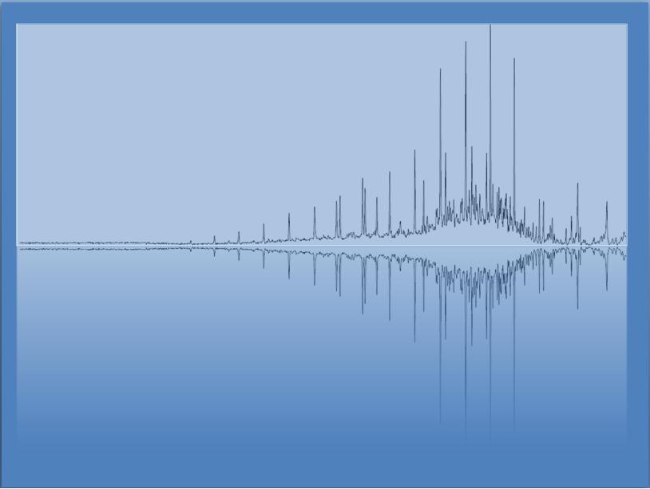
Energy (Heat) of Temperature and Phase Changes
Chem 3A- Yates

Slide 2
Phase Transitions
Solid → Liquid
( ? )
Liquid → Gas
(_______)
Solid → Gas
(_______)
Liquid → Solid
(_______)
Gas → Liquid
(_______)
Gas → Solid
(_______)

Slide 3
Phase Transitions
Solid → Liquid
(Fusion/Melting)
Liquid → Gas
( ? )
Solid → Gas
(_______)
Liquid → Solid
(_______)
Gas → Liquid
(_______)
Gas → Solid
(_______)

Slide 4
Phase Transitions
Solid → Liquid
(Fusion/Melting)
Liquid → Gas
(Vaporization/Boiling)
Solid → Gas
( ? )
Liquid → Solid
(_______)
Gas → Liquid
(_______)
Gas → Solid
(_______)

Slide 5
Phase Transitions
Solid → Liquid
(Fusion/Melting)
Liquid → Gas
(Vaporization/Boiling)
Solid → Gas
(Sublimation)
Liquid → Solid
( ? )
Gas → Liquid
(_______)
Gas → Solid
(_______)

Slide 6
Phase Transitions
Solid → Liquid
(Fusion/Melting)
Liquid → Gas
(Vaporization/Boiling)
Solid → Gas
(Sublimation)
Liquid → Solid
(Freezing/Solidification)
Gas → Liquid
( ? )
Gas → Solid
(_______)

Slide 7
Phase Transitions
Solid → Liquid
(Fusion/Melting)
Liquid → Gas
(Vaporization/Boiling)
Solid → Gas
(Sublimation)
Liquid → Solid
(Freezing/Solidification)
Gas → Liquid
(Condensation)
Gas → Solid
( ? )

Slide 8
Phase Transitions
Solid → Liquid
(Fusion/Melting)
Liquid → Gas
(Vaporization/Boiling)
Solid → Gas
(Sublimation)
Liquid → Solid
(Freezing/Solidification)
Gas → Liquid
(Condensation)
Gas → Solid
(Deposition)

Slide 9
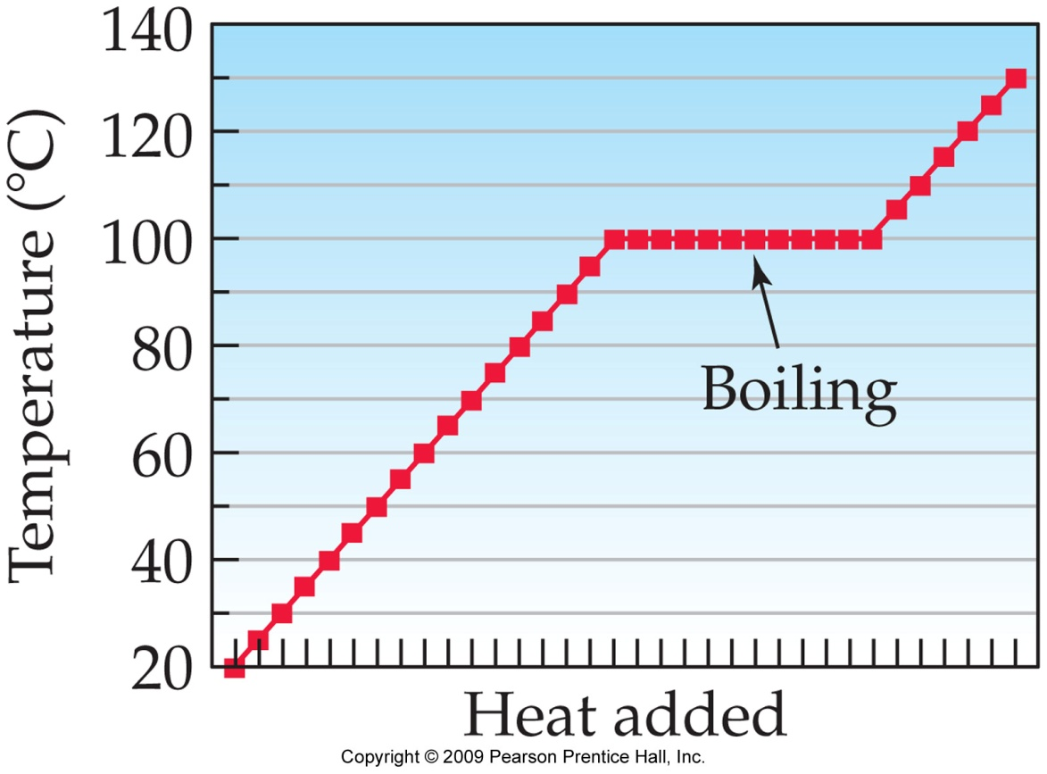
Energetics of Heating/Cooling and phase transitions
Heating/Cooling q = mcΔT
“c” is different for a solid, liquid, or gas
Phase Transitions q = nΔH
n = # of moles
ΔH is the change in
enthalpy (energy)
for phase transition.
(kJ/mol)
heating curve of water

Slide 10
Heating/Cooling
Amount of Heat = Mass x Heat Capacity x Temperature Change
q = m c ΔT
Specific heat (c) =
Heat required to raise
the temperature of 1 g
of a substance by 1 °C.
J/g°C

Slide 11
Specific Heat Capacity (C)
Specific heat = is the amount of heat 1 g of a substance must absorb to raise its temperature by 1 °C.
Units =J/g°C.

Slide 12
Specific Heat Capacities

Slide 13
Calculate Amount of Heat Needed to Raise Temperature of 2.5 g Ga from 25.0 to 29.9 °C
C_{Ga} = 0.372 J/g°C

Slide 14
Example 3.10—Calculate Amount of Heat Needed to Raise Temperature of 2.5 g Ga from 25.0 to 29.9 °C
Write down the Given quantity and its unit.
Given:
m = 2.5 g, T₁ = 25.0 °C,
T₂= 29.9 °C, C = 0.372 J/g°C
Write down the quantity you want to Find and unit.
Find:
q, J
Write down the appropriate Equations.
Equation:
Write a Solution Map.
Solution
Map:
m, C, ΔT
q
Follow the solution map to Solve the problem.
Solution:
Significant figures and round.
Round:
4.557 J = 4.6 J
2 significant figures
Check.
Check:
Units and magnitude are correct.

Slide 15
Example -Calculate the Mass of Water that Can Be Vaporized with 155 KJ of Heat at 100 °C.
∆H_{vap} =
Use ∆H as a conversion factor

Slide 16
Practice—How Much Heat Energy, in kJ, is Required to Vaporize 87 g of Acetone, C₃H₆O, (58.08 g/mol) at 25 °C? (ΔH_{vap} = 31.0 kJ/mol)

Slide 17
Practice—How Much Heat Energy, in kJ, Is Required to Vaporize 87 g of Acetone, C₃H₆O, (MM 58.08) at 25 °C? (ΔH_{vap} = 31.0 kJ/mol), Continued
Given:
Find:
87 g C₃H₆O
kJ
Solution Map:
Relationships:
g C₃H₆O
mol C₃H₆O
kJ
Solution:
Check:
Since the given mass is than one mole, the answer being greater than ΔH_{vap} makes sense.

Slide 18
Practice—How Much Heat Energy, in kJ, is Required to Melt 87 g of Acetone, C₃H₆O, (MM 58.08)? (ΔH_{fus} = 5.69 kJ/mol)

Slide 19
Practice—How Much Heat Energy, in kJ, Is Required to Melt 87 g of Acetone, C₃H₆O, (MM 58.08)?, Continued
Given:
Find:
87 g C₃H₆O
kJ
Solution Map:
Relationships:
g C₃H₆O
mol C₃H₆O
kJ
Solution:
Check:
Since the given mass is more than one mole, the answer being greater than ΔH_{vap} makes sense.

